Slide 1
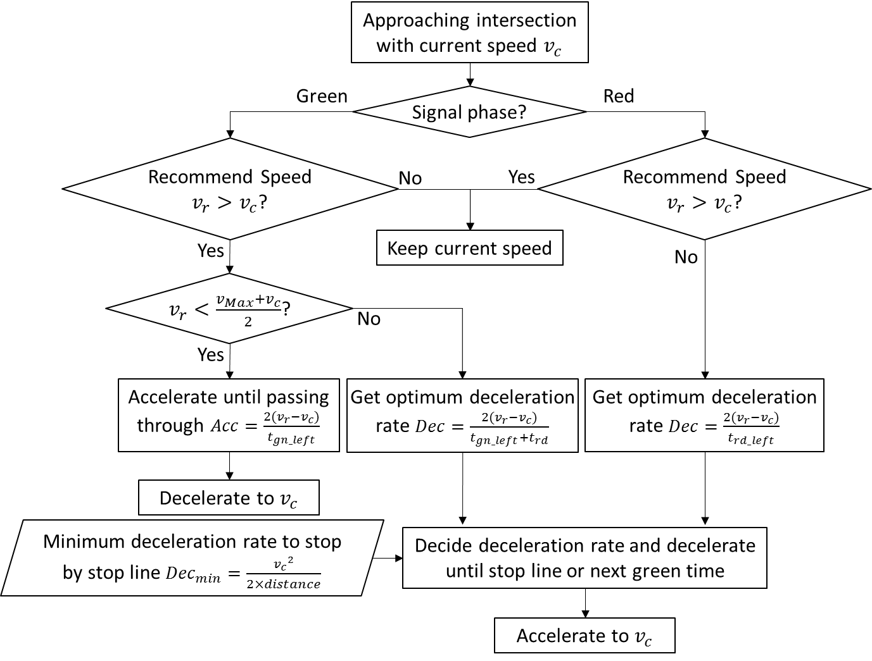
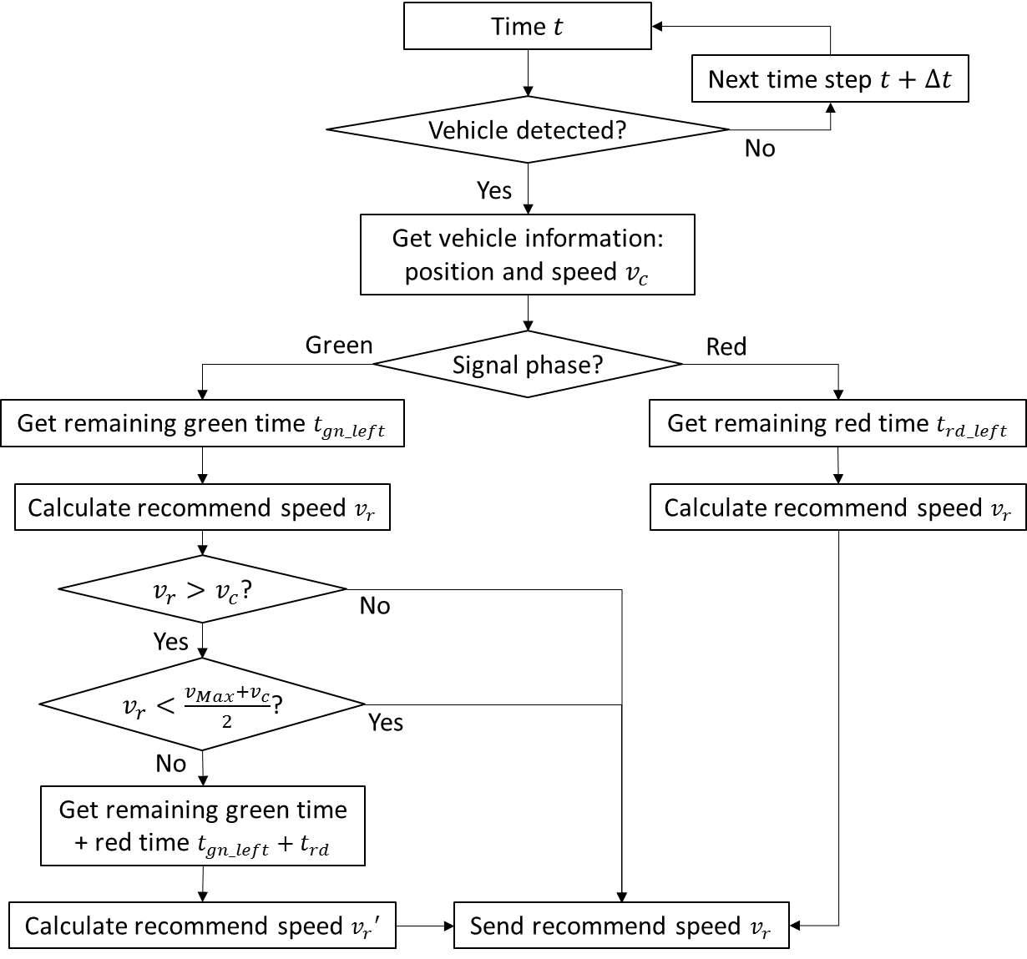
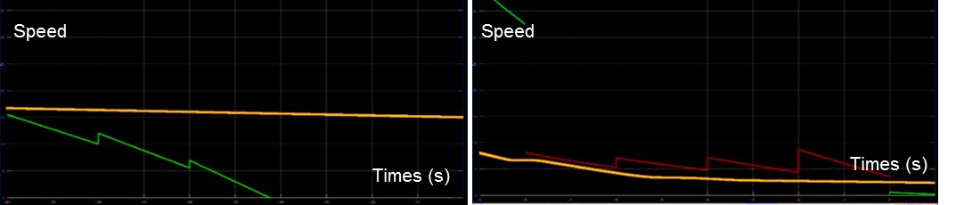
ASSESSING ECO-DRIVING BEHAVIORS USING DRIVING SIMULATOR
Lian Cui, Brian Park
University of Virginia
Research Background
Eco-driving can reduce fuel consumption at signalized intersections using V2I communication. In this research, a driving simulator based Eco-driving behavior and automated vehicle Eco-driving were evaluated. To minimize deceleration or avoid complete stop at traffic signals, the algorithm provides the recommendation speed for drivers. There were 43 drivers in 1st test, and 8 drivers in 2nd test where the drivers were given more time to get comfortable with the interface, and showed improvement in reduction of fuel consumption. Finally, we compared the results with the automated vehicle, which is regarded as ideal behavior of Eco-driving, and showed reduction of over 20% in fuel consumption.
Methodology
On an arterial network with signalized intersections, we added V2I communication system and Eco-driving algorithm using PreScan software, then ran the experiments twice. For the test, each participant first drives under regular condition and then under Eco-driving condition. Finally, we collected velocity data and processed it using VT-Micro Model to evaluate fuel consumption and emissions.
Figure 1. Eco-Driving Control Process and Interface
Figure 2. Decision Process of Automated Vehicle

Slide 2
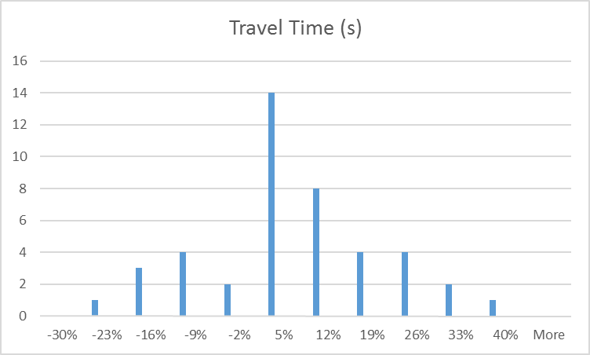
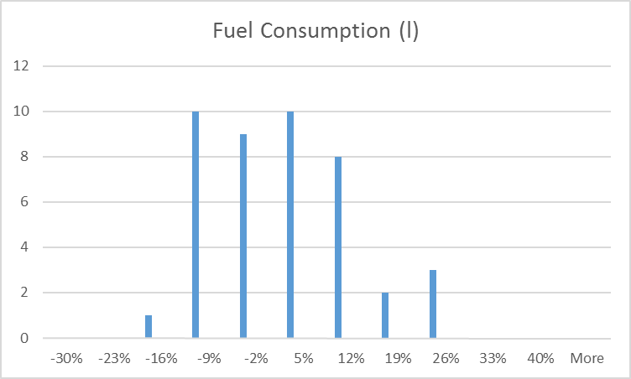
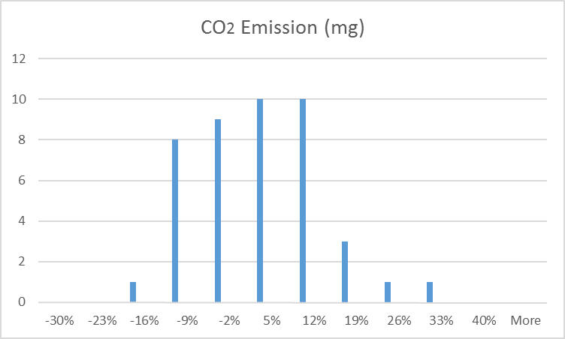
Test Results
Case | Time(s) | Fuel(ml) | CO₂(mg)
Base Case | 103.4 | 129.8 | 426677
Eco-driving (1st Test) | 106.9 | 129.5 | 427839
% Change (%) | 3.4 | -0.28 | 0.27
Eco-driving (2nd Test) | 98.6 | 122.5 | 401947
% Change (%) | -4.64 | -5.68 | -5.80
Automated Vehicle | 79.9 | 101.0 | 321850
% Change (%) | -22.66 | -22.17 | -24.57
Table 1. Average results of four cases
(% 𝐶ℎ𝑎𝑛𝑔𝑒=(𝐸𝑐𝑜𝐷𝑟𝑖𝑣𝑖𝑛𝑔 −𝐵𝑎𝑠𝑒 𝐶𝑎𝑠𝑒)÷𝐵𝑎𝑠𝑒 𝐶𝑎𝑠𝑒 ×100%)
Figure 3. Distribution of Change Rates among Individuals
Conclusions and Future Research
Eco-driving technology has shown great potential in reducing fuel consumption and emissions at signalized intersections. As the drivers became more familiar with the driving simulation environment, they were able to decrease travel time, fuel consumption, and emissions. Compared to the automated vehicle under Eco-driving guidance, under 20% of the trips in base control case has overlap in fuel consumption, and nearly 40% of the trips in Eco-driving 2nd test has overlap with the automated vehicle, which shows that the technology can be effective in a system that involves the driver, but there are also implications for its use in a more automated system. For the future work, we plan to include Eco-signal timing algorithm as well as various traffic conditions.
Acknowledgments
This research project was supported by the GRL Program through the NRF funded by the Ministry of Science, ICT & Future Planning (2013K1A1A2A02078326). We express our gratitude to Ahnaf Choudhury, Deri Harris, and Jacob Sperling for their efforts for collecting the data used in this paper, and Mr. Jeff Blackburn for his support with the PreScan Software from Tass International.

